Slide 1
The changes and fluctuations of the housing market.
By: Fayol Ateufack , Colin Burge, JJ Johnson, Sean Johnson, and Saranjeet Singh

Slide 2
Introduction:
Background information on the housing market: "The housing market has undergone a significant increase in prices in recent years."
Research question and objectives: "We aim to identify the most important variables in predicting house prices and determine the underlying factors contributing to the increase in housing prices."
Importance of the research question: "Understanding the factors that affect housing prices is crucial for making informed decisions in the housing market."

Slide 3
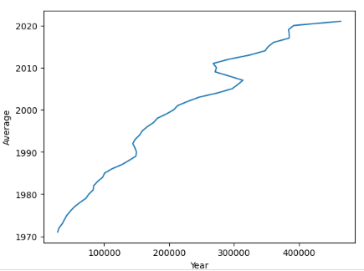
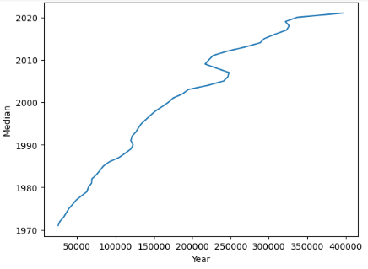
Data and Methods
Overview of the data sources and variables used in the analysis: "We analyzed median and average housing prices, per capita income, population size, GDP, inflation rate, average interest rates on houses, the number of houses sold, and unemployment rate from 1971 to 2021."
Description of the statistical techniques and software used for the analysis: "We used single and multivariable regression techniques and Python libraries such as Pandas, Seaborn, and Scikit-learn for data analysis."

Slide 4

AVERAGE
MEDIAN

Slide 5
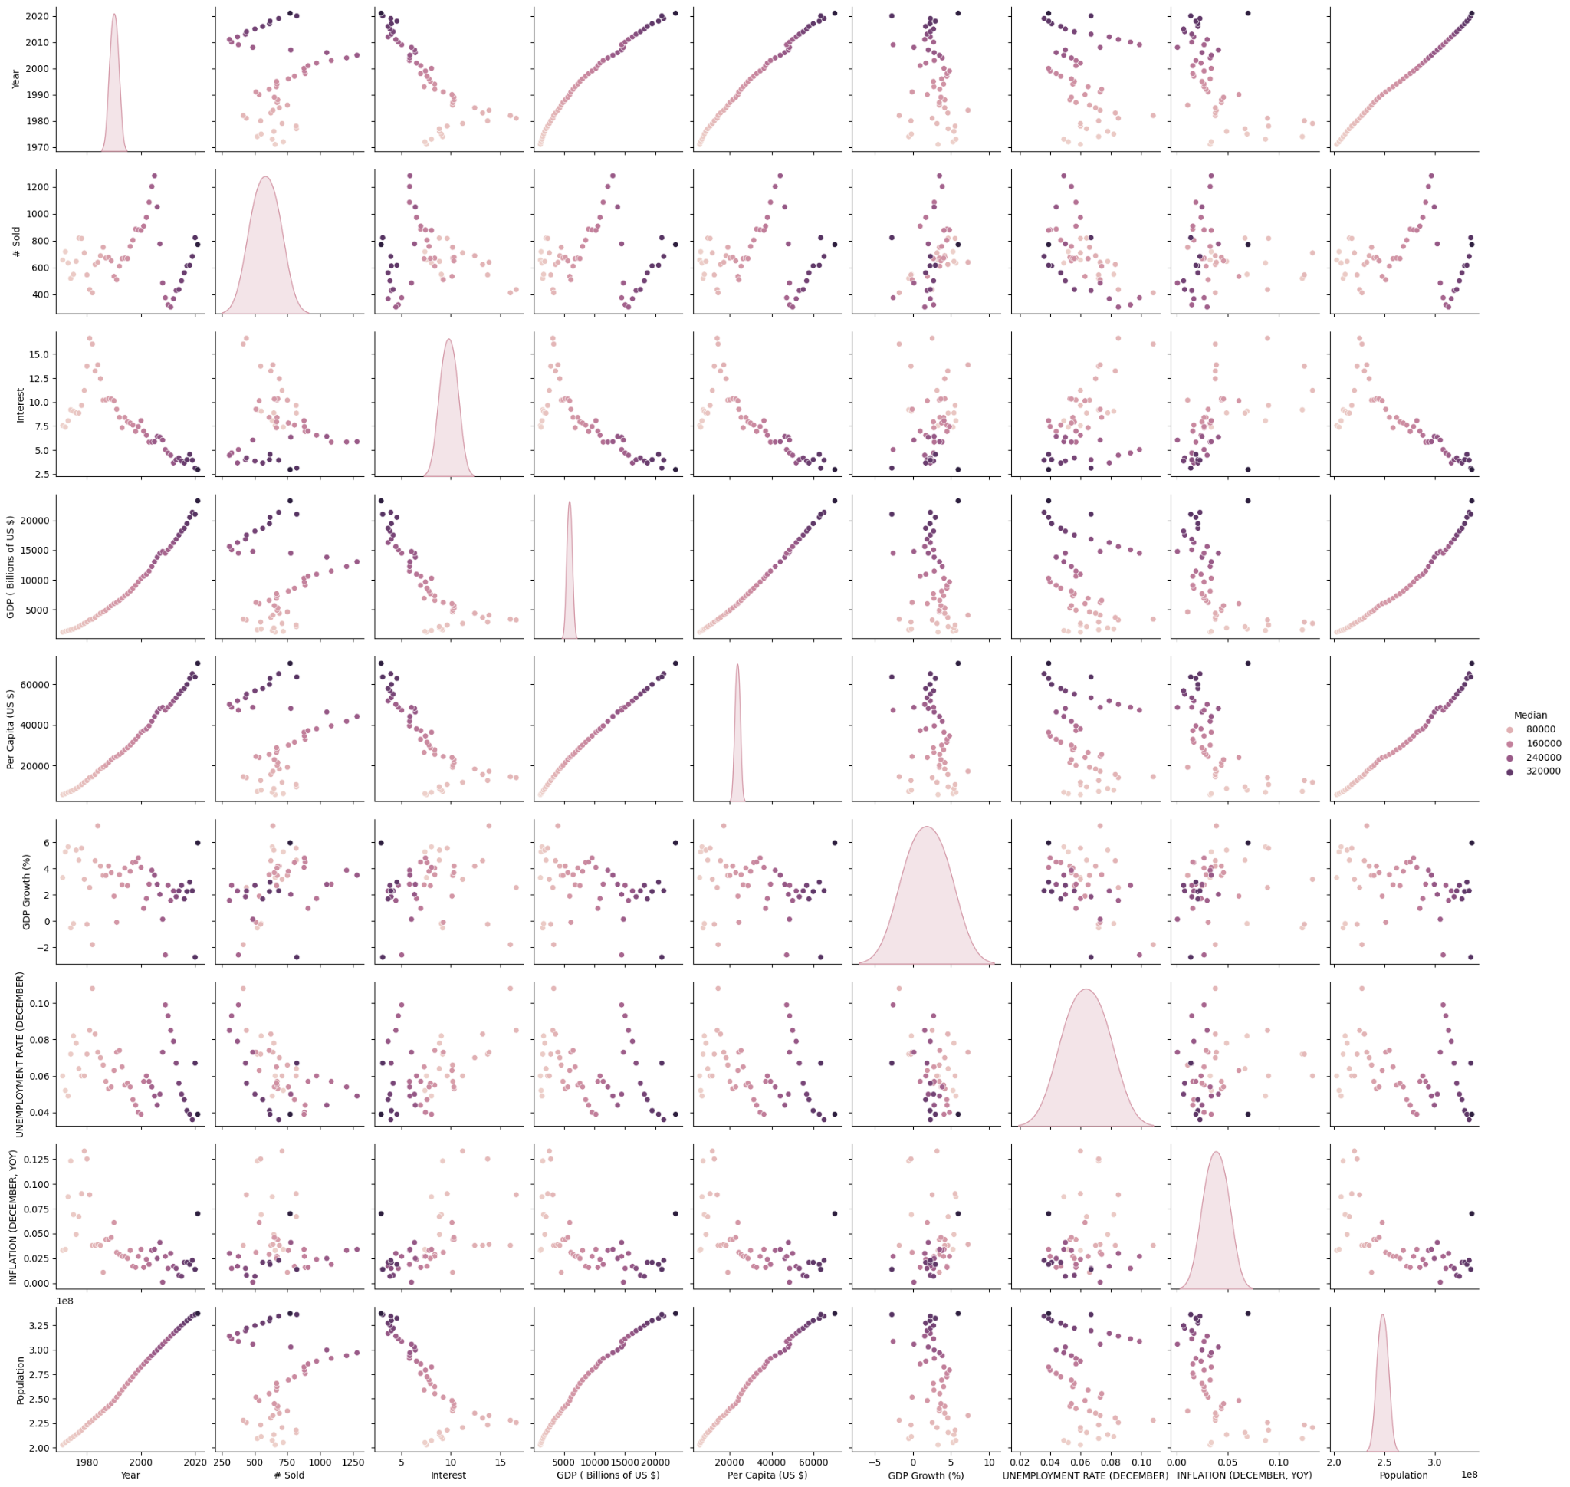
Correlation Analysis
Pairplot and correlation matrix of the variables: "The pairplot and correlation matrix revealed that GDP, per capita income, and population size were closely related."
Discussion of the correlations among the variables: "We found that GDP had the highest correlation(0.99) and accuracy in predicting median house prices."

Slide 6
Results - Regression Analysis
Overview of the regression models used in the analysis: "We used single and multivariable regression to determine the most influential factors on house prices."
Summary of the RMSE values for the top five variables and all variables combined: "The RMSE values for the top five variables were [15,18,34,37,91] thousand dollars. The RMSE value for all variables combined was 5 thousand dollars"
Discussion of the implications of the regression analysis: "Our analysis showed that using all variables together significantly improves the accuracy of predicting median house prices."

Slide 7
Bias and Limitations
Discussion of potential biases and limitations in the analysis: "Potential biases and limitations in the analysis include the exclusion of relevant variables and the assumption of linearity between the variables."
Identification of areas for future research and improvements in the methodology: "Further research is needed to investigate the complex interactions between variables and to improve the methodology used in the analysis.

Slide 8
Conclusion
Summary of the main findings and implications: "Our analysis showed that GDP is the most influential factor in predicting median house prices. Using all variables together significantly improves the accuracy of predicting house prices."
Discussion of the relevance of the findings to policymakers and market participants: "These findings are relevant to policymakers and market participants in making informed decisions in the housing market."

